Slide 1

Solvents and Hydrocarbons
Matthew P. Davey, MD
Oregon Health and Science University
Notes:
Alright, lets keep things going with a discussion on solvents and hydrocarbons. I think this will be a good talk for both acute care providers and also for those taking care of industry workers. Again, just like the other lectures, please let me know if you have any questions or comments as we go along.

Slide 2
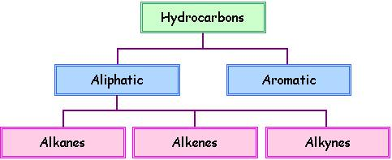

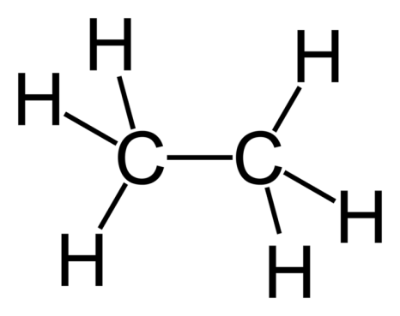
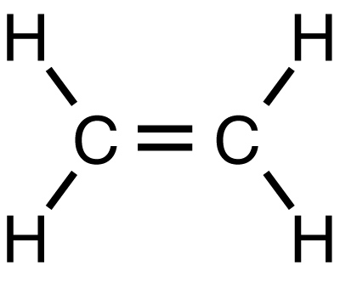
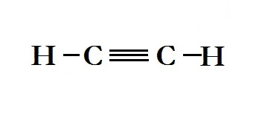
What are we actually talking about?
Notes:
Ok, so why don’t we start at the very beginning with what we actually mean by a hydrocarbon. As the name implies it is made up of both hydrogen and carbon molecules. However, they can be aliphatic or aromatic – with aliphatic being straight or branched chain, and then either saturated like ethane or unsaturated like ethyene or alkynes with triple bonds. And then the aromatics are those with ring structures. Both aliphatic and aromatic compounds can be substituted with halogens or other molecules as we’ll see.

Slide 3
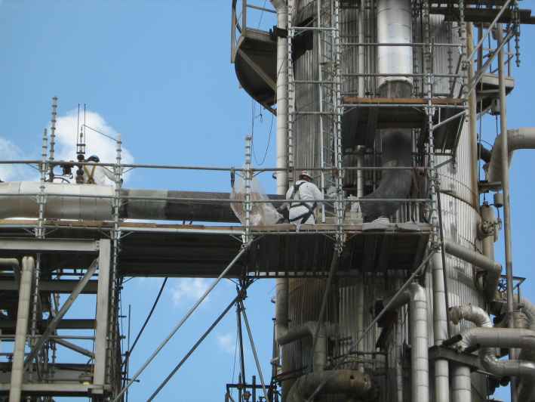


Three Distinct Patient Populations
Occupational Exposures
Intentional Inhalant Abuse
Unintentional Pediatric Exposures
Notes:
And now with hydrocarbons and solvents, we really worry about 3 different distinct patient populations. And because of the route and type of hydrocarbon that they are exposed to all differ, they are at risk for different toxicities. Today, we’ll talk at least briefly about all 3 – whether it’s the petrochemical worker with chronic inhalation or the teenager who is intentionally inhaling toluene, or lastly the unintentional hydrocarbon ingestion in an exploring toddler. We see all 3 of these patients in our emergency rooms and clinics so I’m guess here is no different.

Slide 4

Occupations at Highest Risk
  Petrochemical workers
  Plastics and rubber workers
  Printers
  Laboratory workers
  Painters
  Hazardous waste
  workers
Notes:
Here is a list of the most common occupations that may be at increased risk for a hydrocarbon or solvent toxic exposure. Top of the list is those who work with petrochemicals, but many others including rubber and plastics workers and painters are at risk for long term chronic effects that we will talk about a little bit later.
Here in the picture you can see construction workers working with tar and asphalt. They are at risk for toxic gas exposure to a number of toxins including hydrogen sulfide, carbon monoxide, propane, methane, and other volatilized hydrocarbons. They are also at risk of cutaneous injury through these hot hydrocarbon mixtures which can cause severe burns and the fact that they can harden quickly and are very difficult to remove. To dissolve these particles, it is best to dissolve with other hydrocarbons such as mineral oil and petroleum jelly, proving the point that like really does dissolve like. We will see this principle come up a little bit later as well.

Slide 5
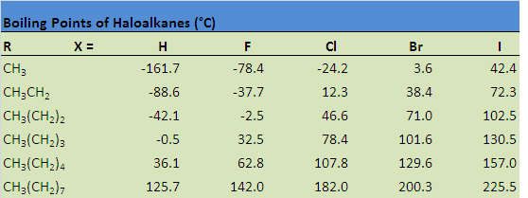
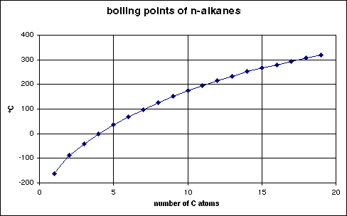
Number of Carbon Atoms Determines the Chemical Properties
Notes:
Like any other compound, its chemical properties will define its pharmacokinetics and toxikinetics. With hydrocarbons, boiling point and vapor pressure help to define its toxicity. As you can see here in both table form on the top and graphical form on the top, that as the number of carbons goes up the boiling point also goes up. Additionally, as you start to substitute with various halogens, the boiling point also changes. This will have consequences in terms of ingestion, inhalation, and the risk of aspiration.

Slide 6
Key Toxicokinetic Points
Absorbed dose depends on:
  Inhalation
    Air concentration, duration of exposure, and minute ventilation
  Ingestion
    Molecular weight (increasing MW, decreasing absorption)
  Dermal
    lipophilicity and hydrophilicity
    Best absorption with water-to-lipid coefficient of 1 (ie. DMSO)
Notes:
We won’t be-labor the toxicokinetic points too much, but it is important to realize that the absorbtion of an inhaled dose is dependent not only on the air conentration, duration exposure, but also on the workers minute ventilation. Oral bioavailability on the other hand is dependent on the hydrocarbon’s molecular weight. And lastly, dermal exposure is dependent on the molecule’s lipophilicity and hydrophilicity. The skin is actually made up of both hydrophilic and lipophilic components, and therefore a molecule with a water/lipid partition coefficient of close to 1 (DMSO) will have the best absorption. Overall, dermal absorption is much less significant compared to something like inhalation

Slide 7

Pulmonary Toxicity
Classically reported after ingestion
Dependent of 3 factors
  Viscosity
  Surface tension
  volatility
Notes:
Hydrocarbons with low viscosities (turpentine, gasoline, naphtha) have a higher tendency for aspiration. In the US, the Consumer Products Safety Commission issued a rule in 2001 that required child-resistant packaging for products that contain 10% or more of hydrocarbon by weight and have a viscosity of less that 100 SUS (which is the units for viscosity).
Surface tension is the same idea as viscosity, but describes a liquids ability to creep. It represents the attractive forces between the molecules. The lower the surface area, the more effectively the liquid can creep and therefore produce a higher aspiration risk.
Volatility on the other hand is the tendency of a liquid to become a gas. The higher the volatility, the more likely the aspiration risk and ability to displace oxygen and lead to hypoxia.

Slide 8
Other risk factors of aspiration pneumonitis
Amount ingested
  Greater than 30ml
Presence or absence of vomiting
Initial episode of coughing, gagging, choking
Notes:
The other commonly reported risk factors for aspiration after ingestion are the amount ingested, the presence of vomiting, coughing or gagging. In one study pulmonary toxicity developed 52% of people ingesting over 30ml, while only 39% in those who ingested less than 10ml. Clearly, this is not a very sensitive or specific risk factor. There are many cases of severe ARDS after only 5ml exposure. In fact, none of these by themselves have very high sensitivity for ruling out aspiration

Slide 9
Clinical Pulmonary Findings
Crackles, rhonchi
Bronchospasm
Hypoxemia
Hemoptysis
Methemoglobinemia
  Nitrogen containing hydrocarbons
    Aniline, nitrobenzene
Notes:
With aspiration or severe inhalational injury, you will see clinical findings of a pneumonitis with crackles and wheezing, with severe cases with refractory hypoxemia and hemoptysis. You can also see methemoglobinemia in nitrogen containing hydrocarbons such as nitrobenzene.

Slide 10
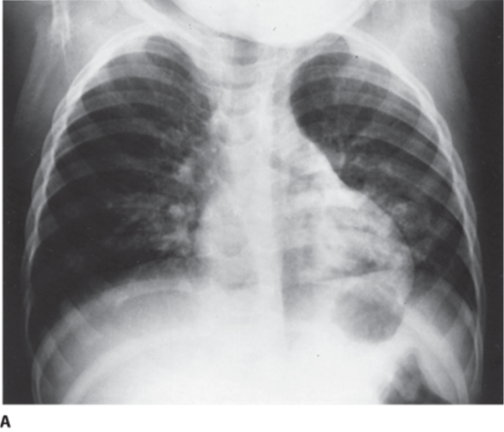
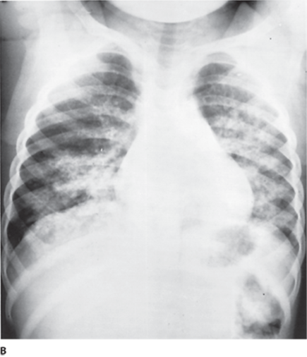
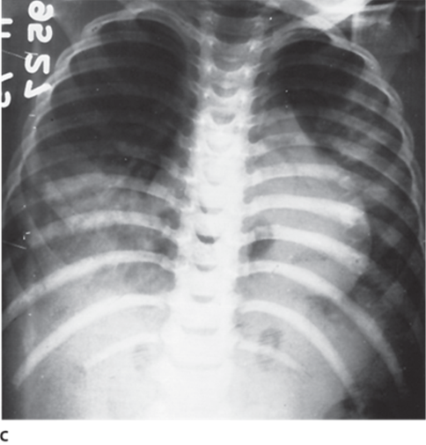
Radiographic Pulmonary Findings
Day 1
Day 2
Day 6
Notes:
Here is a series of classic hydrocarbon aspiration pneumonitis. The initial xray shows patchy densities appearing in the basilar areas of both lung fields with increased interstitial markings and peribronchial thickening. On day 2 you can see more extensive diffuse alveolar infiltrates are apparent. And then finally on day 6, you see dense consolidation and atelectasis are evident in the right lower lobe.
Findings of pneumonitis can develop as early as 15 minutes or as late as 24 hours, which makes disposition and decision making difficult. This is complicated more by the fact that CXR on initial presentation are not predictive in either symptomatic or asymptomatic patients. However, 90% of radiographic abnormalities are present by 4 hours.
postingestion.

Slide 11
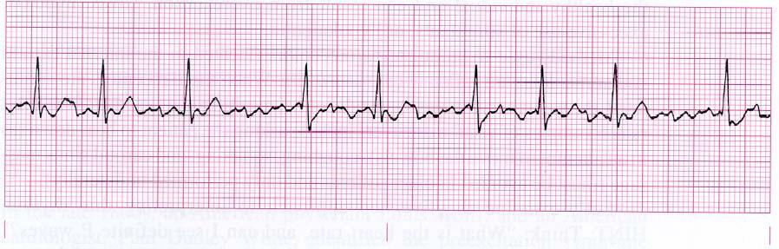
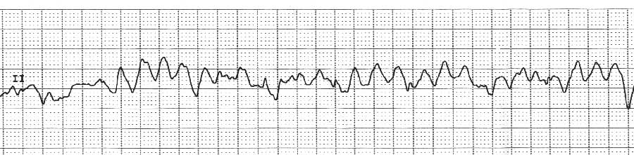
Cardiac Toxicity
Myocardial sensitization and “sudden sniffing death”
Notes:
Hydrocarbon exposure can precipitate a wide range of dysrhythmias through myocardial sensitization. This includes everything from atrial fibrillation to junctional rhythms to ventricular tachycardia and fibrillation. The mechanism is not entirely worked out, but is thought to be from sodium channel inhibition, potassium channel inhibition, and changes in the gap junctions. This is exaggerated in the setting of catecholamines and so the classic scenario, is one of the adolescent abusing hydrocarbon inhalants who is suddenly caught or surprised and collapses in a malignant dysrhythmia and hence the term “sudden sniffing death”.

Slide 12
CNS Toxicity
Acute
  Transient CNS excitation (after inhalation or ingestion)
  Followed by CNS depression
    Similar mechanism to alcohol and other inhaled anesthetics
Notes:
Acutely, hydrocarbons that are inhaled may cause short episode of excitation – which is often what people who are abusing inhalants are going after. However, this is quickly followed by CNS and respiratory depression, very similar to other inhaled general anesthetics.

Slide 13
Chronic CNS Toxicity
Chronic occupational exposure → chronic neurobehavioral syndrome
  “occupational solvent encephalopathy”
  “painter’s syndrome”
  “organic solvent syndrome”
Toluene as the model solvent
Notes:
Aside from the acute CNS effects described, hydrocarbons and solvents are well known to cause chronic CNS toxicity. Given it has been described in many different occupational settings, it has been called by a variety of names. However, toluene, in both occupational settings and in the setting of intentional abuse has been the best documented.

Slide 14
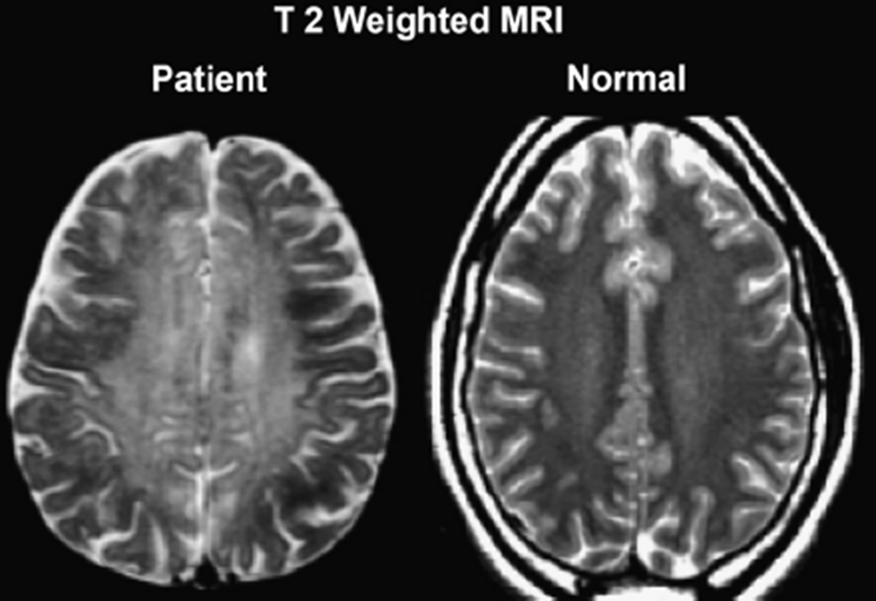
Chronic Toluene (Solvent) Leukoencephalopathy
Ataxia
Spasticity
Dysarthria
Dementia
Psychiatr Clin N Am. 2013;(36):293-302.
Notes:
Clinical features of chronic exposure can lead to ataxia, spasticity, dysarthria, and dementia. Autopsy studies of the brains of chronic toluene abusers show atrophy and mottling of the white matter, as though the lipid-based myelin were dissolved away – again proving the point that like-dissolves-like.
Additionally, you can see behavioral changes, impaired concentration, poor vision, and deafness
Here is a T2 weighted MRI of a chronic toluene abuser on the left and a normal individual on the right. On the left you can see the diffuse hyperintensity of the cerebral white matter consistent with widespread myelin injury.

Slide 15
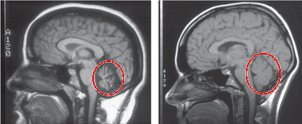
Other CNS Findings
Notes:
Additional findings in chronic toluene and solvent exposure include mild-to-moderate cerebellar and cortical atrophy. Here you can see quite an atrophied cerebellum on the left compared to a normal on the right.
In addition, if you were to do an EEG, you might also see a diffuse slowing pattern. Brainstem auditory-evoked responses may also be abnormal and have been shown to be a sensitive indicator of toluene-induced CNS damage.

Slide 16
Other toluene fun facts
Chronic exposure can also cause:
  distal RTA
  Proximal RTA or Fanconi-like syndrome
  Hypokalemia
  Hyperchloremic (non-gap) metabolic acidosis
  Mechanism unknown
Hippuric acid is primary urinary metabolite
Notes:
Toluene also has several other unique properties to it in chronic exposure. It is well documented to cause a distal RTA and rarely will cause a proximal RTA and fanconi-like syndrome. This will also be associated with a hyperchloremic non-gap metabolic acidosis.
To look for ongoing occupatioanl exposure, urinary hippuric acid is the test of choice.

Slide 17
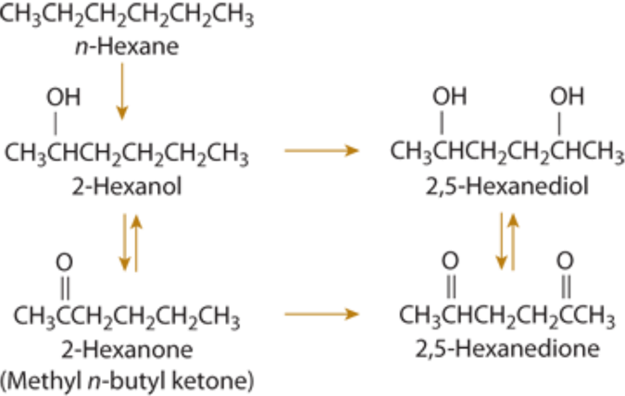
Peripheral Nervous System
Peripheral neuropathy well described with n-hexane and methyl-n-butyl ketone (MnBK)
  “dying-back” axonopathy from a common intermediate: 2,5-hexanedione
Notes:
In addition to the CNS toxicity from hydrocarbons and solvents, many of these are also known to cause peripheral nervous system toxicity. 2 well known and well documented are n-hexane and methyl-n-butyl ketone or MnBK. Hexane can be found in gasoline, glues, and cements among other things. MnBK is also found in many glues, cements, and paints. Both of these are well described to cause peripheral neuropathy in animals and humans after chronic exposure. The axonopathy is the classic “dying-back” and starts distal and eventually makes it way more proximal.
Here you can see the common metabolism of both n-hexane and methyl n-butyl ketone to the neurotoxic 2,5-hexanedione intermediate.

Slide 18
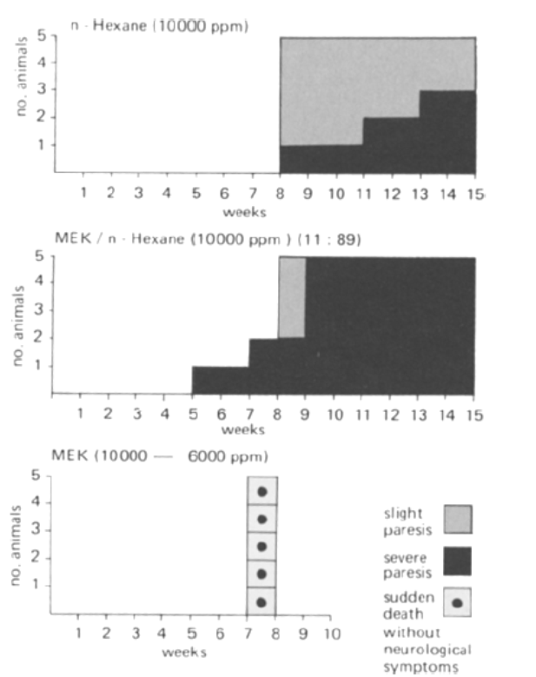
MEK Potentiates Neurotoxicity of n-hexane and MnBK
Notes:
Methyl ethyl ketone or MEK on the other hand is not thought to cause direct neurotoxicity. It is also found in glues, cements, and paints. However, it has been shown to potentiate the neurotoxicity of hexane and MnBK by altering their metabolism. There have been case reports however of large ingestions that may have caused direct neurotoxicity.
This graph is from a 1970s animal study on peripheral neuropathy from n-hexane and MEK. You can see in the top graph, the animals are only exposed to n-hexane and slowly the animals develop slight paresis in gray and then severe paresis in black. You can see in the next graph, when MEK is added to n-hexane, the onset of paresis is potentiated and is much more rapid. In the final bottom graph you can see the animals are exposed to only MEK and there are no animals with peripheral paresis. Interestingly though, the animals died from sudden death, but none developed peripheral neuropathy.

Slide 19
Other solvent causes of peripheral neuropathy
Carbon disulfide – manufacturing (viscose rayon)
Acrylamide – polymer manufacturing; flocculating agents
Ethylene oxide – sterilants (endoscopy equipment)
Trichloroethylene (TCE) – solvent, cleanser, and degreaser
Notes:
In addition to MnBK and n-hexane, there is a rather long list of other solvents and hydrocarbons that are known to cause a similar dying back axonopathy and peripheral neuropathy. One of these is carbon disulfide which we most often associated with the production of viscose rayon. In addition to a peripheral neuropathy, one can also see parkinsonism and choreoathetoid movements with carbon disulfide.
Additionally, acrylamide – which is used in the manufacturing of various polymers; ethylene oxide which is found in sterilants, and also TCE which is most commonly found in solvent, cleanser, and degreaser – are all on the list of solvents that are well documented to cause peripheral neuropathy.

Slide 20
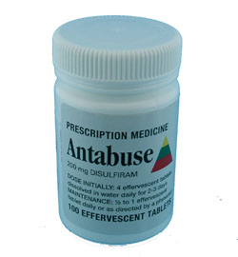
A bit more on TCE…
Trigeminal neuralgia
  Reported to develop within 12 hours of single exposure
“degreaser’s flush”
  Inhibits aldehyde dehydrogenase
Use as an anesthetic has been abandoned
  Acute cardiotoxicity, hepatotoxicity, nephrotoxicity
Notes:
I just wanted to speak a little bit more about TCE or trichloroethylene exposure because it does have some other interesting toxicities. For years it was used as a general anesthetics, but has since been abandoned due to hydrocarbon cardiotoxicity. Besides the peripheral neuropathy, it has also been thought to be a cause of trigeminal neuralgia, even from a large single exposure. This is thought to be from TCE decomposition products.
Additionally, TCE also inhibits aldehyde dehydrogenase and thus creates aa disulfram-like reaction with alcohol and causes flushing, and nausea and vomiting much like you would see alcohol and antabuse.

Slide 21
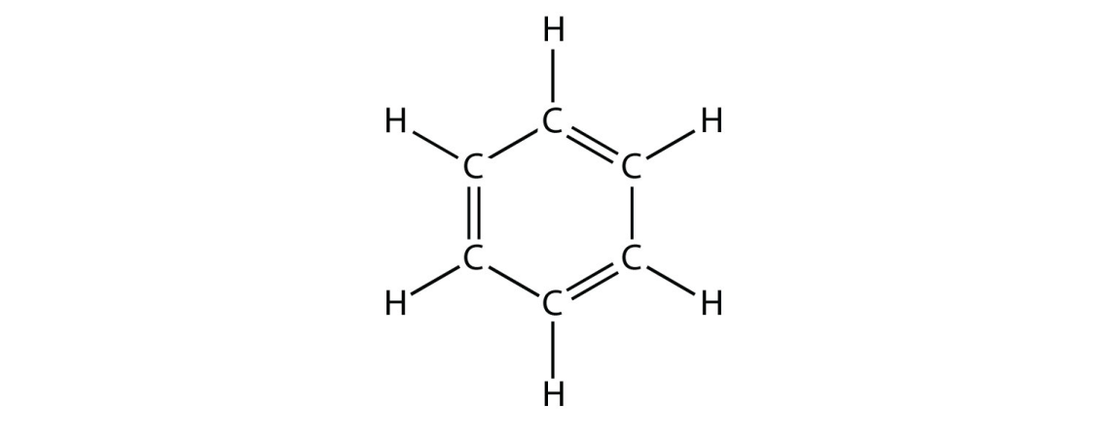
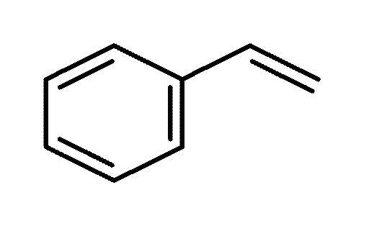
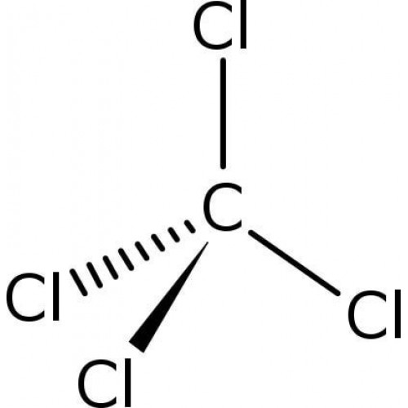
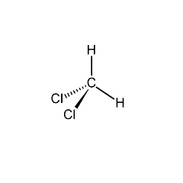
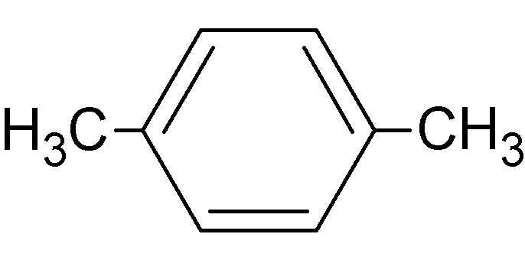
A few more interesting solvents and hydrocarbons
Notes:
Now lets go over a few more interesting solvents and hydrocarbons with some unique characteristics and toxicities.
These in particular were selected an important in the Bangkok and the Thailand communities, so if you have had any special experience with any other these hydrocarbons, we would love to hear about it.

Slide 22

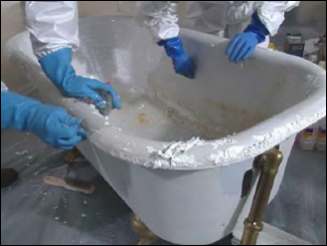
Methylene Chloride
Paint removers, cleansers, degreasers, propellants
Notes:
The first one we can talk about is methylene chloride. It is commonly found in paint removers, cleansers, degreasers, aerosol propellants. Like other halogenated hydrocarbons it can cause rapid general anesthesia by inhalation. The fascinating fact about it – AND other similar 1 carbon halomethanes – is that it is metabolized by 2E1 as seen here to carbon monoxide. And thus it can lead to significant, delayed, and prolonged carboxyhemoglobinemia.
One classic unfortunate case is shown here of bathtub refinishing. Unfortunately there have been many deaths of bathtub refinishers using methylene chloride paint stripping products in poorly ventilated bathrooms. Death in these cases are likely from a combination of CNS and respiratory depression as well as carbon monoxide poisoning.

Slide 23
Linear correlation of methylene chloride levels and COHb% in workers
Notes:
Here you can see the nice direct, positive linear correlation between increasing methylene chloride concentrations and carboxyhemoglobin levels. This graph however, does not say anything about the amount of time required for conversion.

Slide 24

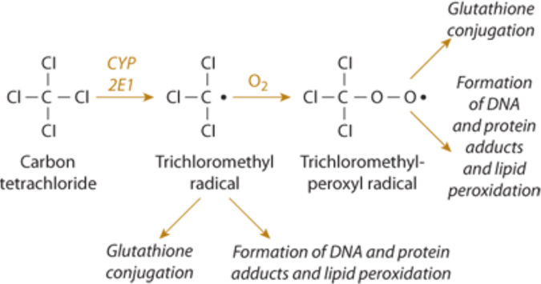
Carbon Tetrachloride
Industrial solvent, reagent
Hepato- and nephro-toxic
  Common in repetitive occupational exposure
Notes:
While not technically a hydrocarbon given its obvious lack of hydrgens, carbon tetrachloride has long been used as an industrial solvent and reagent. However its uses has dramatically declined now that it has been identified as a potent hepatic and renal toxin. The mechanism of toxicity is shown here. Carbon tetrachloride undergoes oxidation via CYP2E1 to trichloromethyl radical and a peroxyl radical. These cause lipid peroxidation and protein adducts in the liver which causes centrilobular necrosis the same as acetaminophen-induce hepatotoxicity.

Slide 25
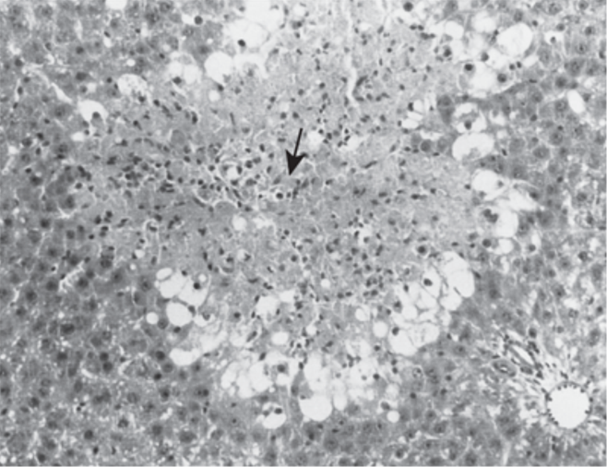
Centrilobular Necrosis from CCl₄
Notes:
Here you can see the centrilobular necrosis and significant leukocyte infiltration caused by carbon tetrachloride.

Slide 26

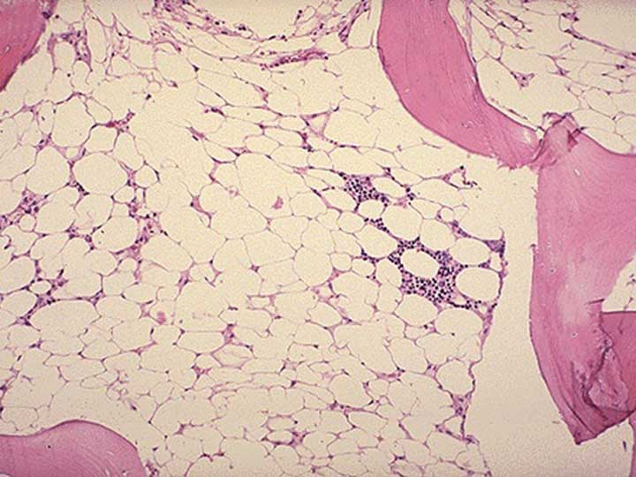
Benzene
Petroleum, rubber, paint industries
Hematotoxin
  Acute hemolysis
  Aplastic anemia
  Acute myelogenous leukemia
Urinary phenol (metabolite) marker of industrial exposure
Notes:
Benzene is a hydrocarbon that also has very unique properties and toxicities that are worth noting. It is found most abundantly in the petrochemical industry with the heaviest exposure in the clean-up and transfer of petroleum products. It is a potent hematotoxin. The classic cause of death in chronic benzene poisoning is aplastic anemia, which you can see here in the picture of the quite hypocellular bone marrow.
Although there are several important benzene metabolites including hydroxyquinol, quinol, and catechol; phenol is the best urinary metabolite to serve as a biologic marker of ongoing industrial exposure.

Slide 27

Styrene
Greatest employee exposure risk:
  Production using polyester resins
Used in plastics, styrofoam, insulation, paint, and boat manufacture
Indices of exposure: DNA and protein adducts, cytogenetic damage
Notes:
As we have come to realize, styrene is an important chemical here in Thailand. You can see the chemical structure here in the upper right hand corner. Its terminal bond makes is a good candidate for polymerization, and in fact it is used for the manufacture of different polyester resins, plastics, styrofoams, insulation, paint, and in the manufacture of boats.
Following its chronic exposure is a little bit more difficult, and instead of a metabolite, it is best to follow DNA and protein adducts, or alternatively looking at cytogenetic damage as well.

Slide 28
Styrene Toxicity
Acute:
  Mucosal membrane irritant
  CNS and respiratory depression
Chronic
  ??conflicting data carcinogenicity
  ??lymphoma, leukemia
Notes:
The acute toxicity of styrene in the occupational setting is mostly of a local irritant to the skin, mucous membranes and the respiratory tract. Additionally, just like all the other hydrocarbons, it creates a dose dependent CNS and ultimately respiratory depression.
Chronically, long term epidemiology studies looking for blood malignancies have been conflicting. The best studies of workers only working with styrene products have failed to show any malignancy relationship. There have been other studies in the setting of other known carcinogens such as benzene where there has been an increase in lymphoma and leukemia. The current concensus is that styrene is not considered a carcinogen at this time.

Slide 29
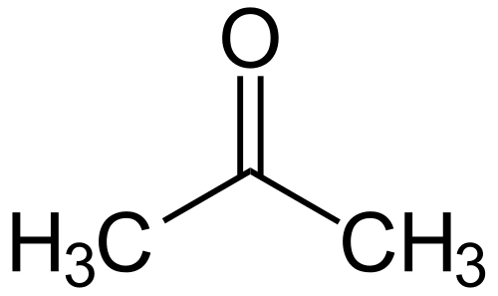
Acetone
Endogenous substance
Plumbers, glues, nail polish remover, semiconductor industry
CNS depression at very high concentrations (>12,000ppm)
Irritant: eyes, nose, throat
Not thought to be a carcinogen
Highly flammable
Notes:
Acetone is another very common solvent – for both for personal and industrial use. It’s seen in a wide range of uses from plumbing to the semiconductor industry. It’s an endogenous substance, mainly from the metabolism of fatty acids. Because of this, it is not thought to be a very toxic substance. In an inhalational exposure, it takes an extremely high concentration to cause CNS depression. It should mainly be thought of as an eye, nose, and throat irritant and the treatment should be supportive. It is highly flammable and thus a large amount of the injuries from acetone are actually from explosions and not its inherent toxicity.

Slide 30
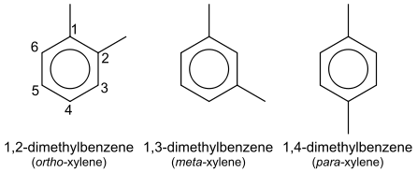
Xylene
Degreaser, solvent, petrochemical industry (gasoline, aircraft fuel)
Acute toxicity:
  CNS depression, mucous membrane irritant
Chronic toxicity:
  CNS, hepatic (100 to 1000ppm)
  Reproductive tract malformations (60 to 800ppm)
Notes:
Xylene is also produced in the petrochemical distillation process. It is used as a component of several different fuel sources and is also found in industrial degreasers and solvents. Much like acetone, in high concentration settings it can cause CNS depression and local irritation. In chronic exposures, it looks much more like toluene having long term CNS, hepatic, and reproductive tract dysfunction at the concentrations seen here.

Slide 31
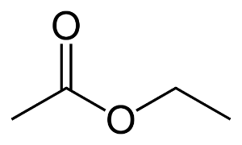

Ethyl Acetate
Glues, nail polish removers, paints, decaffeinating tea and coffee, cigarettes
Acute toxicity:
  CNS depression, mucous membrane irritant
One study possibly showing increased risk of lymphatic leukemia in rubber workers
Notes:
Ethyl acetate is the last solvent that we’ll touch on right now. It gets most of its use in glues and nail polish removers. Interestingly it also is used in the decaffeination of teas and coffee. Also ethyl acetate is the most common ester in wine and is what gives the perception of “fruitines” in wine. So if it’s in the liquids we drink, it can’t be all bad; and that’s what we generally find. The acute inhalational toxicity is limited to mucosal irritation, and CNS depression only with very large concentrations in enclosed spaces. And in general it is not considered a carcinogen per IARC or any other organization. There was one possible correlation in a rubber tire factory, but this is inconclusive giving the cofounding with many other carcinogenic toxins.

Slide 32
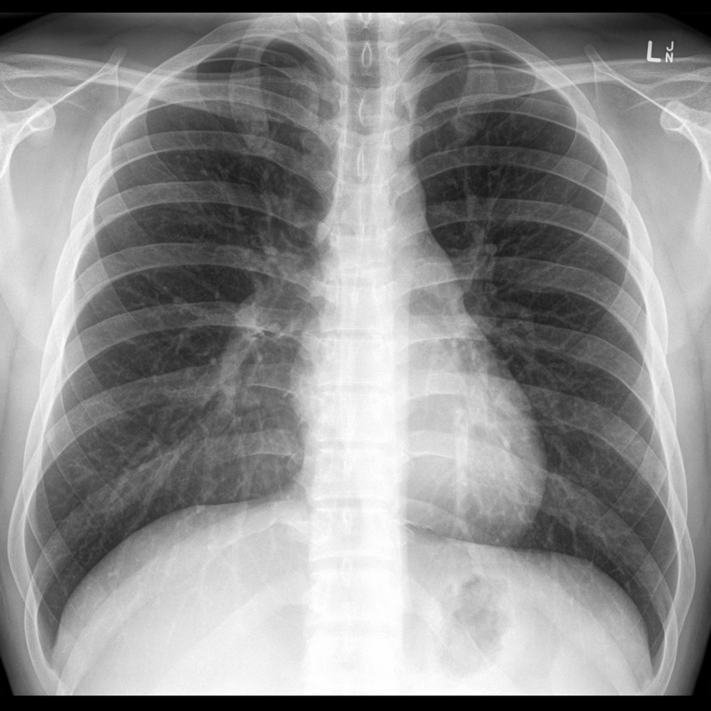
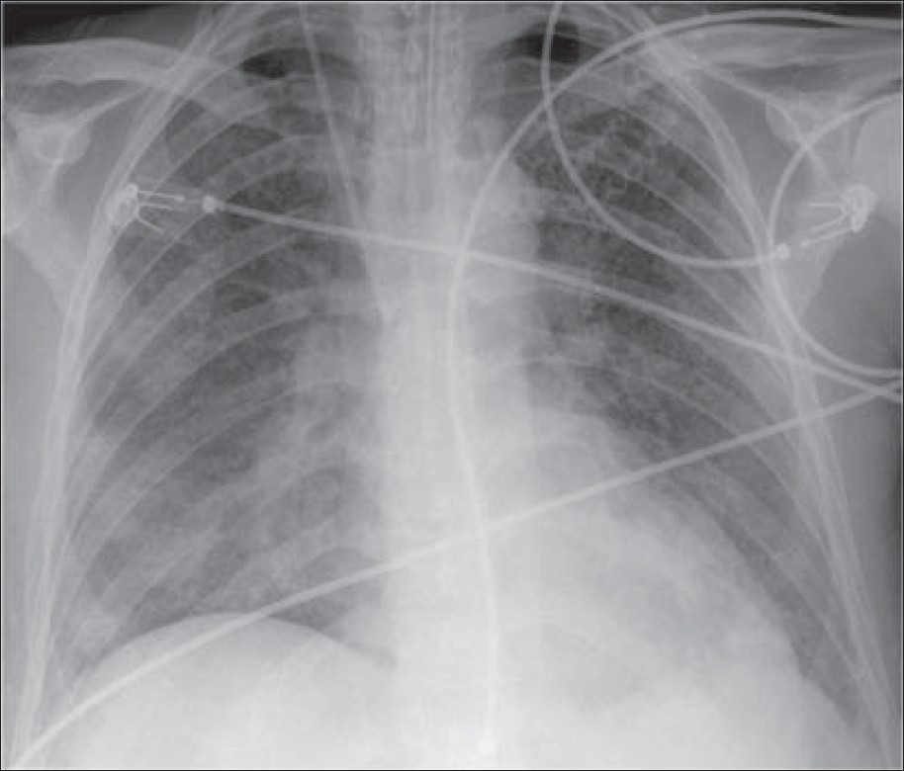
Diagnostics
Chest xray
  Immediately in severely symptomatic patients
  Ingestions – 6 hours post-ingestion
Notes:
In terms of A chest xray is recommended to be obtained after inhalational and oral exposures. Any obviously symptomatic patient with evidence of pulmonary toxicity should receive a cxr. However, after ingestions, as we said, initial xray can be negative and are poorly predictive. Instead after 6 hours, greater than 90% of patients who go on to develop aspiration pneumonitis will have a positive CXR by then.
You can argue that a patient that has been observed for 6 hours after ingestion, with adequate oxygenation, is not tachypneic, has a normal lung exam and CXR like the one seen here on the left, can be safely discharged with close follow up.

Slide 33
Diagnostics
General tests may have some utility:
  ECG
  Pulse oximetry
  Blood gas
  Electrolytes
  Complete blood counts
  CK
Notes:
Acutely, in general, for significant exposures, some general diagnostics may serve some benefit. An EKG to look for any dysrhythmias, a pulse ox and blood gas to monitor oxygenation, ventilation, and acid-base status. Additionally looking for rhabdomyolysis in a patient with prolonged CNS depression or down time is also useful

Slide 34
Testing Target Organ Toxicities
Bone marrow in benzene toxicity
Liver function in CCl₄
Peripheral nervous system in n-hexane/MnBK
Carboxyhemoglobin in a paint stripper with chest pain
Urinary trichloroethanol and trichloroacetic acid in TCE worker with bouts of dizziness
Sudden death in a huffer
Notes:
But in general, you will get more for your money basing a majority of you testing on the history and the physical as we do with all of medicine. We can also test various bioassays for the specific hydrocarbons or their metabolites in blood, urine, or breath. Obviously these will be of little utility in the emergent scenario given around their usual long turn around time, but can help in forensics or chronic cases. Here are a few examples of such testing – including a lot of things we’ve touched on in previous slides including looking at the bone marrow in chronically exposed benzene workers, hepatic function in CCl4 exposures. Nerve conduction studies can be done in workers exposed to neurotoxic agents. Finally, forensic testing can be done on autopsy – here an example would be of a huffer who was found with sudden death.

Slide 35
Hydrocarbon – Solvent Management
Decontamination
  Gastric lavage and activate charcoal contraindicated
Antibiotics
  Usually held despite hyperthermia and infiltrate
Corticosteroids
  Usually held as well
Avoid catecholamines (if possible) given risk of myocardial sensitization
Notes:
The principles of decontamination follow as for all other exposures that we have talked about to date. The exception largely comes with ingestions and doing gastric decontamination. Gastric emptying and the use of activated charcoal is thought to increase the risk of aspiration and thus should be avoided in hydrocarbon ingestions.
Many patients with hydrocarbon pneumonitis will have hyperthermia and an infiltrate on their chest xray and thus it is very tempting to throw antibiotics at these patients. However, several studies have shown that antibiotics does not change the clinical outcomes or length of stay. Its recommended to reserve them for an identified infection.
Corticosteroids are also tempting to try to decrease the large inflammatory response of the pneumonitis, but human and animal trials have failed to show a clinical difference and may increase the risk of a bacterial superinfection. One potential application is in the setting of hydrocarbon-induced stridor and upper airway injury and edema.

Slide 36
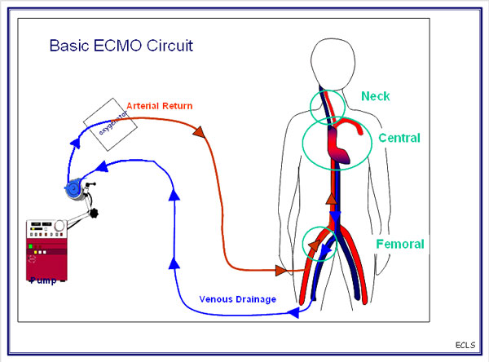
Managing Hydrocarbon Pneumonitis Can be Quite Difficult
Treat like severe ARDS:
  High PEEP
  High-frequency jet ventilation (HFJV)
  Extracorporeal membrane oxygenation (ECMO)
Notes:
Patients with severe hydrocarbon pneumonitis often times are close to impossible to oxygenate and thus oftentimes possible difficult management problems. You can start with the same principles of treating ARDS – using low tidal volumes and high PEEP. However, oftentimes this is not enough and you have to resort to high frequency jet ventilation, or when that fails, going to ECMO which you can see here – is basically running all of the deoxygenated blood through an artificial oxygenator and then back into the circulation.

Slide 37
Hydrocarbon Summary
Chemical properties determine the toxicity
Acute CNS depression, but chronic leukoencephalopathy
Myocardial sensitization
End-organ toxicities:
  Methylene chloride – carbon monoxide
  Carbon tetrachloride – hepatic failure
  Benzene – aplastic anemia, AML
Notes:
While we managed to go over a lot of information on hydrocarbons in a short amount of time, here are a couple of key take home points you should try to remember. The first being that the particular molecular formula will determine the molecular properties, and this will ultimately lead to unique toxicity. Acutely, most or all of the hydrocarbons will lead to CNS depression, but chronically, many of them have been known to cause a toxic encephalopathy. Don’t forget amount the myocardial sensitization effect that hydrocarbons have and how it predisposes especially inhalant abusers to dysrhythmias. And finally, certain hydrocarbons do have unique characteristics that are important to remember such as methylene chloride releasing carbon monoxide, carbon tetrachloride causing centrilobular hepatic necrosis, and chronic benzene exposure leading to aplastic anemia and ultimately AML.

Slide 38

Questions??
Notes:
And with that I would be happy to open it up to some questions or comments if you have any .

